Slide 1
Detection of Malaria from blood smear using Deep Learning
Instructor : Shan Lin
ESE.534 Cyber Physical Systems
Presented by:
Vignesh Chivukula (112714486)
Nitin Asthana (112995559)
Meghana Jayaswamy (112871790)

Slide 2
Outline
Introduction
Motivation
Proposal
Implementation
Evaluation
Results
Conclusion
Future Scope

Slide 3
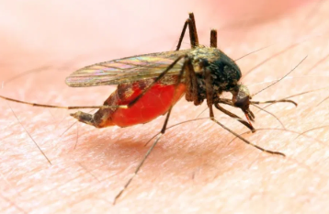
Introduction
What is Malaria?
human disease that is caused by sporozoan parasites (genus Plasmodium) in the red blood cells.
is transmitted by the bite of female anopheline mosquitoes.
It is characterized by periodic attacks of chills and fever.
Female anopheline mosquito

Slide 4
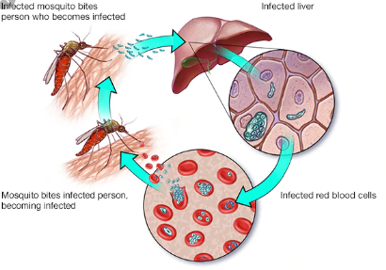
Stages of Malaria
Infected Liver
Infected mosquito bites person who becomes infected
Mosquito bites infected person becoming infected
Infected red blood cells

Slide 5
Key facts about Malaria
In 2017, there were an estimated 219 million cases of malaria in 87 countries.
The estimated number of malaria deaths stood at 435 000 in 2017.
The WHO African Region carries a disproportionately high share of the global malaria burden. In 2017, the region was home to 92% of malaria cases and 93% of malaria deaths.
Total funding for malaria control and elimination reached an estimated US$ 3.1 billion in 2017. Contributions from governments of endemic countries amounted to US$ 900 million, representing 28% of total funding.

Slide 6
Clinical Diagnosis:
Patient’s symptoms and on phyical findings.
Confirmed by a laboratory test for malaria
Antigen detection:
Test kits to detect antigen.
Rapid Diagnostic Tests (RDT’s).
Useful alternative to microscopy.
Existing Work
Microscopic diagnosis:
Gold standard test.
Specimen is stained.
Blood smear is examined under microscope
Molecular Diagnosis:
Uses polymerase chain reaction (PCR).
more sensitive
results are not quickly available

Slide 7
Motivation
Early diagnosis helps in quick and complete recovery of the patient.
Currently, malarial detection is done by using the blood smears of the patient by a clinician manually and this process takes up 2-3 days which is quite a
long time.
Rapid Diagnostic Tests (RDTs) have been developed, which are quicker but are not very accurate.
Complicated cases involves the use of ICU care, dialysis and ventilator support
So, improving the speed and maintaining the accuracy of these tests is very important and helpful.

Slide 8
Proposal
Idea here is to achieve a good amount of speed with an efficient diagnosis
The blood cell image samples are collected and labelled into datasets
This labelled dataset is then trained using Deep Neural Network and saved
Whenever required, the microscopic images of blood cells from the blood smear of patient is taken using a high definition smartphone
These cell images are processed using the saved model to determine the presence of parasites in them

Slide 9
Dataset
The dataset for this project was a collection of parasitized and uninfected images
About 27k images of both cases, which are labelled, are used for training the model
Source: https://lhncbc.nlm.nih.gov/publication/pub9932
It contained the images along with the ground truth value (labels)
Labelled dataset helped in training the model easily

Slide 10
Dataset Processing
This labelled data was initially split into Training, Validation and Test datasets
The Training dataset was a major part, with 80% of the total data
Remaining 20% is used as Test dataset
Of the 80% Training dataset, 10% was used as Validation dataset

Slide 11
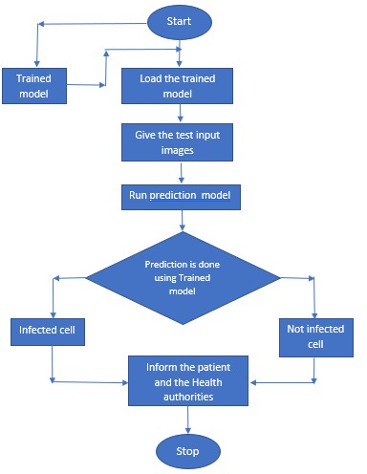
Implementation - Overview
The detection of malaria in is as follows:

Slide 12
Training Model
The training of our model is done using Deep Neural Networks
We used 3 layers of training and Keras libraries to perform the training
Before training, the training images were augmented, so as to get a robust training set
After this preprocessing was performed, the Training was performed on the training dataset

Slide 13
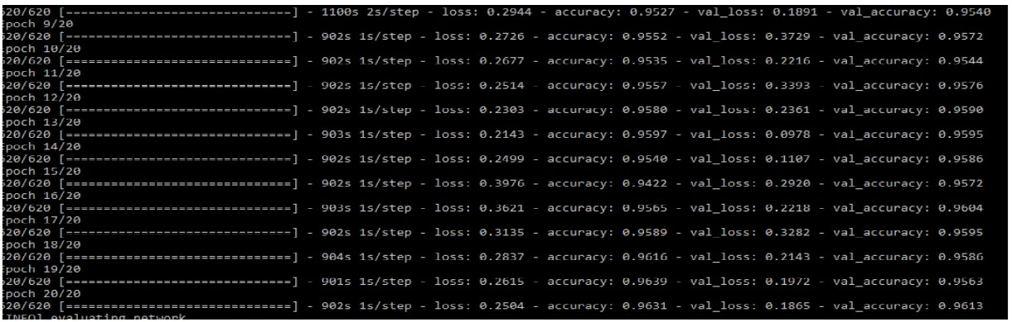
Training Model (Contd)
The training is performed for number of times (epochs) till we get a good accuracy on the model
Here, we used 20 epochs to perform the training
The trained model is then saved using Pickle library

Slide 14
Implementation
The trained model is used to perform the detection on our test image.
To perform quick detection, saved models are used
At the start of detection, trained model is loaded
Detection is performed on the test images
Based on the detection output, a proper feedback is sent to the user and authorities based on result

Slide 15
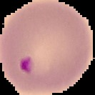
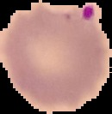


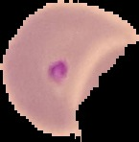
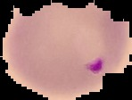


Image Dataset
Following are the images of infected and uninfected cells
Infected UnInfected

Slide 16
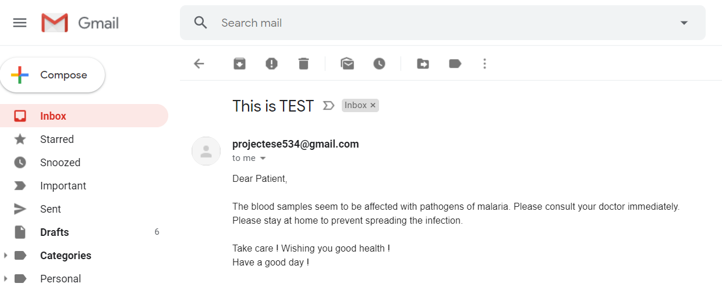
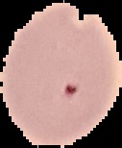
Detection and Response
A test image was provided and the detection was performed
Based on the detected value, a feedback was sent to the patient and concerned authorities
Test Image Response from Application
Using the feedback, the health authorities can take necessary steps to prevent further infection in the locality of the patient.

Slide 17
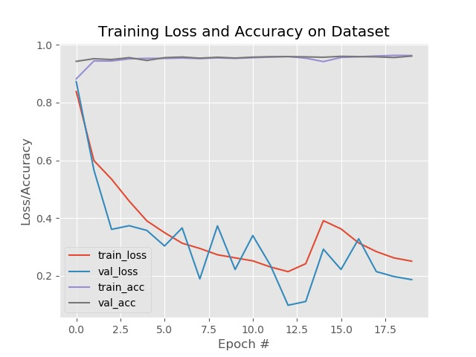
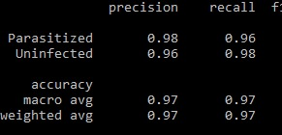
System Evaluation
The evaluation was performed on the model and accuracy was determined.
Accuracy of the Model
Accuracy was found to be 97% for this model
accuracy

Slide 18
Results
It is seen that the model provides us a malaria detection application with accuracy of 97%
The accuracy of the model increases as the number of epochs increases
For the initial epochs till #2, the accuracy is low (around 80 %) and it gradually increases till 97%
We have a loaded model and so the detection is also quicker (around 2 minutes)

Slide 19
Conclusion
The project shows how the Deep learning can be used to detect the infection of malaria in blood cells
The images taken from a high definition smartphone camera and microscope are used
Prediction is performed on these images at a very high speed
The results are obtained within a few minutes, which is very much quicker compared to traditional methods used currently

Slide 20
Future Work
Implementation of this model as a smartphone application
Determination of the exact species of the malaria causing parasite
Improving the efficiency to obtain even higher accuracy
Implementation of this model for determination of similar diseases

Slide 21
Thank you !

